Slide 1
Cinematic Records Database
Magnus Hjorleifsson Ram Kishore Karuppiah Nadar Venkateswaran

Slide 2
Introduction and Purpose
In this dataset, we dissect the basic financial aspects of the film industry and look at the top-rated directors and actors. We explore insightful details on budgets, box office earnings, ratings, genres, and more on 6000 movies, giving a great overview on the movie’s performance both financially and in the audience perspectives.
Our project delves into the financial aspects of the film industry while also exploring the prominent directors and actors with high acclaim. We offer comprehensive insights into crucial details such as its budget, box office earnings, movie ratings, genres, cast, producers, and other valuable information.

Slide 3
Potential Users and Applications
We wanted to investigate the financial and audience perspective of movies and find commonalities between the top performing movies.
Film Industry Professionals: Producers, directors and screenwriters can utilize this dataset to make informed decisions regarding genre distribution, profitable directors, profitable actors, best rated directors, and best rated actors.
Film Investors: Provide insight to financial analysts and investors in the cinematic market to understand the correlation between budget investments and box office returns. This dataset can also be leveraged to find the commonalities behind what would make a profitable film.

Slide 4
Data Sources
We decided to use two different sources of data that are interdependent to help enrich the dataset and ensure the data is as accurate as possible.
Sources:
The Movie Database API - stores information on over 800,000 different movies including the name of the movie, genres, a unique ID, original language, release date, and much more.
Wikipedia – “a free online encyclopedia, created and edited by volunteers around the world”. This has articles on just about every movie including information about the plot of the movie, directors, starring actors, producers, running time, budget of the movie, and the amount of money made in the box office.

Slide 5
Acquiring the Data
Rather than investigating each of the 800,000 movies in the movie database and the millions of links on Wikipedia, we decided to restrict our initial data finds a bit.
Criteria:
Any movie where the original language is English.
Any movie released after January 1st, 2010
Any movie where the vote count greater than 100 (to restrict smaller, unknown movies)

Slide 6
Acquiring the Data
To obtain and parse the data:
1. We make an initial call to the API which returns a full list of movies and the unique movie ID within the API.
2. Constructs a Wikipedia link based on the title of the movie.
Initially, this will replace spaces with “_”. Ex. Movie Title -> Movie_Title
It can also try Movie_Title_(film) and Movie_Title_(2023_film) based on the return values
3. Uses the BeautifulSoup module for web scraping and parsing the HTML.
4. From here, we use helper functions to pull the table of information from Wikipedia and parse the necessary information to the correct format.
5. We use a separate helper function to pull all the paragraphs from the plot subsection.
4. We make a call to the movie database API through a different endpoint to find additional details such as runtime, average voter rating, number of voters, overview of the movie, release date, and the genres associated.

Slide 7
Preprocessing Data
Wikipedia was much more difficult to parse than the API
Once the table is found with BeautifulSoup, we parse it and make it into usable data:
Store starring actors, directors, screenplay, producers, countries and genres in an array
Parse numerical values into integers and float values to be utilized in analysis
We pulled the “box office” and “budget” from Wikipedia which have several different formats:
$400 million – replace $, split by space, multiplication to find integer value
$200-300 million – replace $, find average of left and right elements, multiplication to find integer value
$40+ million – replace $, replace +, multiplication to find integer value
$1.023 billion – replace $, multiplication to find integer value
$300,000 – replace $, replace ,
After data is parsed, we store information from each data source into its own dictionary structure and combine it together to form the final result.

Slide 8
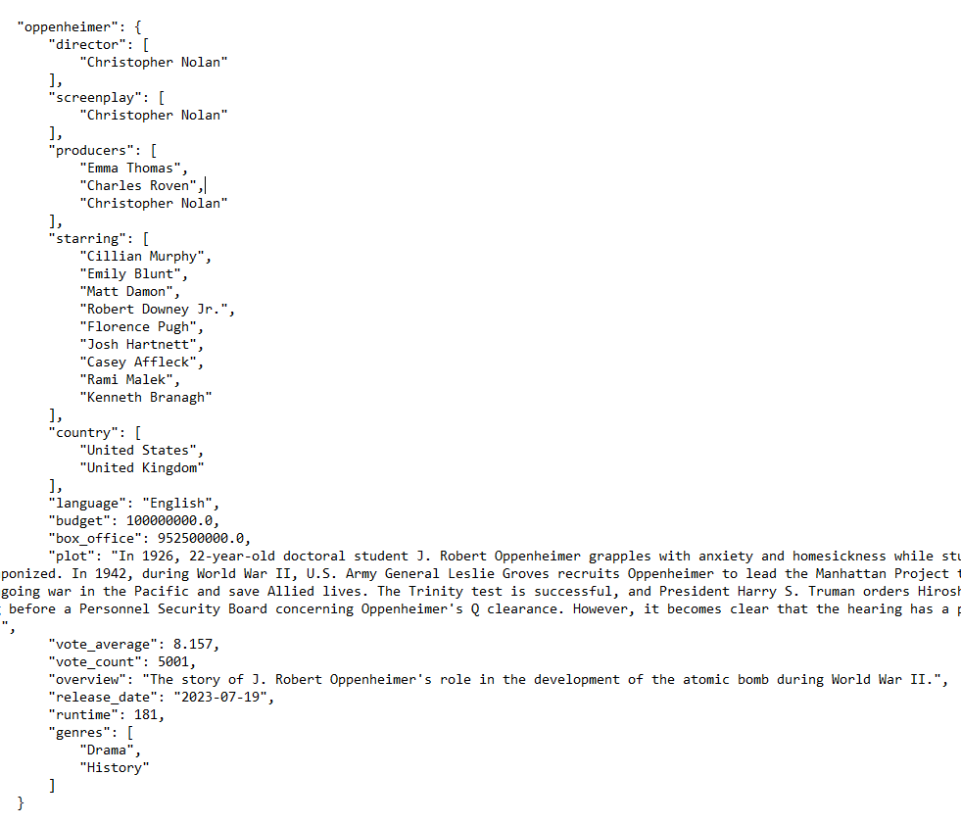
Distribution
We decided to use a JSON output format for the final dataset since it is easy to read (when formatted with indents) and easy to parse using Python.
Once the final dictionary is fully created, it will write to an all_movies.json file within the same directory.
To utilize the dataset, simply download the JSON file, read it into a python script, and use it as needed

Slide 9
Access Rights
Sources Used:
Wikipedia
Available through public use
Since Wikipedia is a public knowledge repository, anyone can access its contents without restriction.
However, this may lead to inaccurate or incomplete information
TMDB
Requires an account created on themoviedb.org website.
User authentication is required to access the movie database.
Sources considered, but not used:
Rotten Tomatoes
No publicly available API
IMDB
Web scraping prohibited without explicit permission.
API requires an AWS developer account

Slide 10
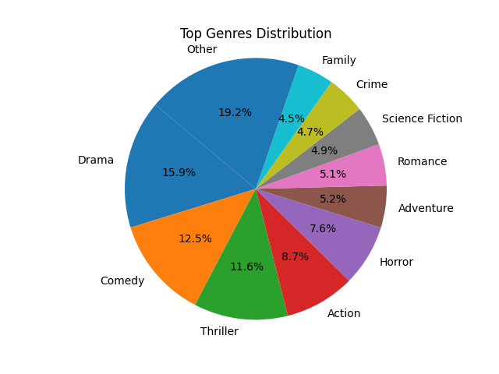
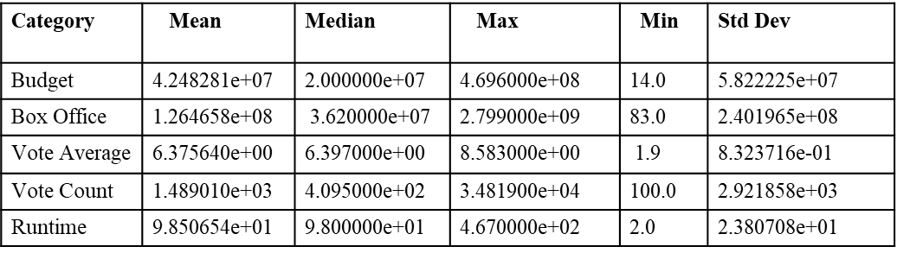
Analysis – Tables and Figures
Genre Distribution
Mean, median, maximum, minimum, standard deviation for numerical categories

Slide 11
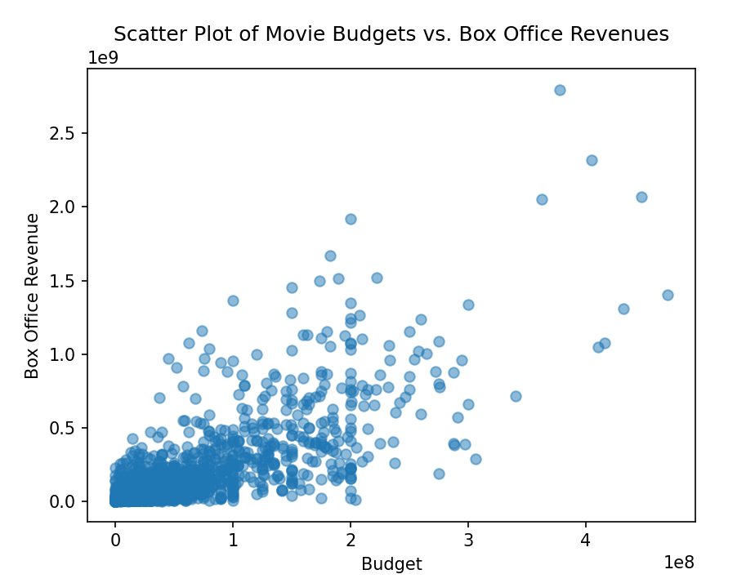
Analysis – Tables and Figures

Slide 12
Analysis
Most profitable directors (sum up the profits of all movies directed):
Anthony Russo & Joe Russo: $891.7M
Christopher Nolan: $579.3M
Most profitable actors (sum up the profits of all movies the actor was in):
Robert Downey Jr.: $1,768.7M
Scarlett Johansson: $1,588.1M
Actors with the most movies:
Bruce Willis: 40
Nicolas Cage: 34
Most common genres:
Drama – 15.9%
Comedy – 12.5%
Thriller – 11.6%
Action – 8.7%

Slide 13
Issues and Limitations
Wikipedia URL links
We couldn’t capture Wikipedia output for every movie due to unstandardized URL formats
Some fields are different than anticipated
Wikipedia isn’t always consistent with the budget and box office reports
Inconsistent number parsing
Due to Wikipedia’s inconsistent formatting with the numeric values
Missing fields in API and Wikipedia
Information not reported or not within Wikipedia page
Skewed analysis towards most profitable movie
Weighs more profitable/higher voter count movies heavier since we used a weighted average to calculate the averages
Could only navigate through 500 pages in TMDB API

Slide 14
Team Contributions
Magnus Hjorleifsson
Created full list of movies using the API and their corresponding IDs
Created Wikipedia link and web scraped necessary information
Parsed data from Wikipedia
Assisted on PowerPoint
Created README file
Ram Kishore
Analysis of the dataset
Created tables and figures for analysis visualization
Added extra API details into each movie
Assisted on PowerPoint

